Slide 1
Processor
Prof. Hakim Weatherspoon
CS 3410, Spring 2015
Computer Science
Cornell University
See P&H Chapter: 2.16-2.20, 4.1-4.4, Appendix B
Notes:
Old See P&H Chapter 2.16-20, 4.1-4

Slide 2
Announcements
Project Partner finding assignment on CMS
Office hours over break

Slide 3
Announcements
Make sure to go to your Lab Section this week
Lab2 due in class this week (it is not homework)
Lab1: Completed Lab1 due this Friday, Feb 13th, before winter break
Note, a Design Document is due when you submit Lab1 final circuit
Work alone
Save your work!
  Save often. Verify file is non-zero. Periodically save to Dropbox, email.
  Beware of MacOSX 10.5 (leopard) and 10.6 (snow-leopard)
Homework1 is out
Due a week before prelim1, Monday, February 23rd
Work on problems incrementally, as we cover them in lecture (i.e. part 1)
Office Hours for help
Work alone
Work alone, BUT use your resources
  Lab Section, Piazza.com, Office Hours
  Class notes, book, Sections, CSUGLab

Slide 4
Announcements
Check online syllabus/schedule
  http://www.cs.cornell.edu/Courses/CS3410/2015sp/schedule.html
Slides and Reading for lectures
Office Hours
Pictures of all TAs
Homework and Programming Assignments
Dates to keep in Mind
  Prelims: Tue Mar 3rd and Thur April 30th
  Lab 1: Due this Friday, Feb 13th before Winter break
  Proj2: Due Thur Mar 26th before Spring break
  Final Project: Due when final would be (not known until Feb 14th)
Schedule is subject to change

Slide 5
Collaboration, Late, Re-grading Policies
“Black Board” Collaboration Policy
  Can discuss approach together on a “black board”
  Leave and write up solution independently
  Do not copy solutions
  Late Policy
  Each person has a total of four “slip days”
  Max of two slip days for any individual assignment
  Slip days deducted first for any late assignment,
  cannot selectively apply slip days
  For projects, slip days are deducted from all partners
  25% deducted per day late after slip days are exhausted
  Regrade policy
  Submit written request to lead TA,
  and lead TA will pick a different grader
  Submit another written request,
  lead TA will regrade directly
  Submit yet another written request for professor to regrade.

Slide 6
Big Picture: Building a Processor
memory
register
file
inst
alu
+4
+4
addr
=?
PC
d_{in}
d_{out}
control
cmp
offset
memory
new
pc
target
imm
extend
A Single cycle processor

Slide 7
Goal for Today
Understanding the basics of a processor
  We now have enough building blocks to build machines that can perform non-trivial computational tasks
  Putting it all together:
  Arithmetic Logic Unit (ALU)—Lab0 & 1, Lecture 2 & 3
  Register File—Lecture 4 and 5
  Memory—Lecture 5
    SRAM: cache
    DRAM: main memory
  Instruction-types
  Instruction Datapaths

Slide 8
MIPS Register File
memory
register
file
inst
alu
+4
+4
addr
=?
PC
d_{in}
d_{out}
control
cmp
offset
memory
new
pc
target
imm
extend
A Single cycle processor

Slide 9
MIPS Register file
MIPS register file
  32 registers, 32-bits each (with r0 wired to zero)
  Write port indexed via R_{W}
    Writes occur on falling edge
    but only if WE is high
  Read ports indexed via R_{A}, R_{B}
Dual-Read-Port
Single-Write-Port
32 x 32
Register File
Q_{A}
D_{W}
32
32
Q_{B}
32
WE
R_{W}
R_{A}
R_{B}
1
5
5
5

Slide 10
MIPS Register file
MIPS register file
  32 registers, 32-bits each (with r0 wired to zero)
  Write port indexed via R_{W}
    Writes occur on falling edge
    but only if WE is high
  Read ports indexed via R_{A}, R_{B}
r1
r2
…
r31
A
W
32
32
B
32
WE
R_{W}
R_{A}
R_{B}
1
5
5
5

Slide 11
MIPS Register file
Registers
  Numbered from 0 to 31.
  Each register can be referred by number or name.
  $0, $1, $2, $3 … $31
  Or, by convention, each register has a name.
    $16 - $23 → $s0 - $s7
    $8 - $15 → $t0 - $t7
    $0 is always $zero.
    Patterson and Hennessy p105.

Slide 12
MIPS Memory
memory
register
file
inst
alu
+4
+4
addr
=?
PC
d_{in}
d_{out}
control
cmp
offset
memory
new
pc
target
imm
extend
A Single cycle processor

Slide 13
MIPS Memory
MIPS Memory
  32-bit address
  32-bit data
  (but byte addressed)
  Enable + 2 bit memory control (mc)
    00: read word (4 byte aligned)
    01: write byte
    10: write halfword (2 byte aligned)
    11: write word (4 byte aligned)
D_{in}
D_{out}
memory
32
32
32
2
addr
mc
E
 | 0x00000000
 | 0x00000001
 | 0x00000002
 | 0x00000003
 | 0x00000004
 | 0x00000005
 | 0x00000006
 | 0x00000007
 | 0x00000008
 | 0x00000009
 | 0x0000000a
 | 0x0000000b
 | ...
 | 0xffffffff
0x05

Slide 14
Putting it all together: Basic Processor
memory
register
file
inst
alu
+4
+4
addr
=?
PC
d_{in}
d_{out}
control
cmp
offset
memory
new
pc
target
imm
extend
A Single cycle processor
Notes:
A processor executes instructions
Processor has some internal state in storage elements (registers)
A memory holds instructions and data
Harvard architecture: separate insts and data
von Neumann architecture: combined inst and data
A bus connects the two

Slide 15
To make a computer
Need a program
Stored program computer
Architectures
von Neumann architecture
Harvard (modified) architecture
Notes:
A stored-program computer is one which stores program instructions in electronic memory. Often the definition is extended with the requirement that the treatment of programs and data in

Slide 16
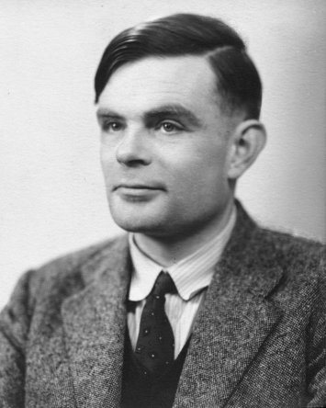

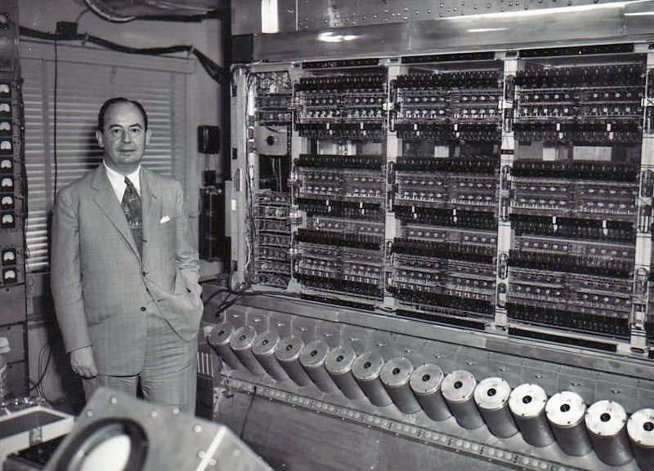
To make a computer
Need a program
Stored program computer
(a Universal Turing Machine)
Architectures
von Neumann architecture
Harvard (modified) architecture
Notes:
A stored-program computer is one which stores program instructions in electronic memory. Often the definition is extended with the requirement that the treatment of programs and data in
http://en.wikipedia.org/wiki/Universal_Turing_machine#Stored-program_computer
Davis makes a persuasive argument that Turing's conception of what is now known as "the stored-program computer", of placing the "action table"—the instructions for the machine—in the same "memory" as the input data, strongly influenced John von Neumann's conception of the first American discrete-symbol (as opposed to analog) computer—the EDVAC (Electronic Discrete Variable Automatic Computer) [previous machine, ENIAC (Electronic Numerical Integrator And Computer), was not a stored-program computer, and was not even in binary, it was in decimal].
See video on von Neumann describe the stored-program computer, 34 minutes into video, https://www.youtube.com/watch?v=VTS9O0CoVng
Also, see clip on Turing in the movie The Imitation Game where Turing states that the Bombe will work in breaking the Enigma machine: https://www.youtube.com/watch?v=MM47hsaYWZE

Slide 17
Putting it all together: Basic Processor
Let’s build a MIPS CPU
  …but using (modified) Harvard architecture
CPU
Data
Memory
Registers
00100000001
00100000010
00010000100
...
Control
data, address,
control
ALU
Program
Memory
10100010000
10110000011
00100010101
...
Notes:
The Harvard architecture is a computer architecture with physically separate storage and signal pathways for instructions and data. --- http://en.wikipedia.org/wiki/Harvard_architecture
Under pure von Neumann architecture the CPU can be either reading an instruction or reading/writing data from/to the memory. Both cannot occur at the same time since the instructions and data use the same bus system. In a computer using the Harvard architecture, the CPU can both read an instruction and perform a data memory access at the same time, even without a cache. A Harvard architecture computer can thus be faster for a given circuit complexity because instruction fetches and data access do not contend for a single memory pathway .
Also, a Harvard architecture machine has distinct code and data address spaces: instruction address zero is not the same as data address zero. Instruction address zero might identify a twenty-four bit value, while data address zero might indicate an eight bit byte that isn't part of that twenty-four bit value.
A modified Harvard architecture machine is very much like a Harvard architecture machine, but it relaxes the strict separation between instruction and data while still letting the CPU concurrently access two (or more) memory buses. The most common modification includes separate instruction and data caches backed by a common address space. While the CPU executes from cache, it acts as a pure Harvard machine. When accessing backing memory, it acts like a von Neumann machine (where code can be moved around like data, a powerful technique). This modification is widespread in modern processors such as the ARM architecture and X86 processors. It is sometimes loosely called a Harvard architecture, overlooking the fact that it is actually "modified".

Slide 18
Takeaway
A processor executes instructions
  Processor has some internal state in storage elements (registers)
A memory holds instructions and data
  (modified) Harvard architecture: separate insts and data
  von Neumann architecture: combined inst and data
A bus connects the two
  We now have enough building blocks to build machines that can perform non-trivial computational tasks

Slide 19
Next Goal
How to program and execute instructions on a MIPS processor?

Slide 20
Levels of Interpretation: Instructions
for (i = 0; i < 10; i++)
printf(“go cucs”);
Programs written in a
High Level Language
  C, Java, Python, Ruby, …
  Loops, control flow, variables
main: addi r2, r0, 10
addi r1, r0, 0
loop: slt r3, r1, r2
...
Need translation to a lower-
level computer understandable
format
  Assembly is human readable machine language
  Processors operate on Machine Language
op=addi r0 r2 10
00100000000000100000000000001010
00100000000000010000000000000000
00000000001000100001100000101010
op=reg r1 r2 r3 func=slt
ALU, Control, Register File, …
Machine Implementation

Slide 21
Levels of Interpretation: Instructions
for (i = 0; i < 10; i++)
printf(“go cucs”);
High Level Language
  C, Java, Python, Ruby, …
  Loops, control flow, variables
main: addi r2, r0, 10
addi r1, r0, 0
loop: slt r3, r1, r2
...
Assembly Language
  No symbols (except labels)
  One operation per statement
op=addi r0 r2 10
00100000000000100000000000001010
00100000000000010000000000000000
00000000001000100001100000101010
Machine Langauge
  Binary-encoded assembly
  Labels become addresses
op=reg r1 r2 r3 func=slt
ALU, Control, Register File, …
Machine Implementation

Slide 22
Instruction Usage
Instructions are stored in memory, encoded in binary
A basic processor
  fetches
  decodes
  executes
one instruction at a time
op=addi r0 r2 10
00100000000000100000000000001010
00100000000000010000000000000000
00000000001000100001100000101010
addr
data
cur inst
pc
adder
decode
execute
regs

Slide 23
MIPS Design Principles
Simplicity favors regularity
  32 bit instructions
Smaller is faster
  Small register file
Make the common case fast
  Include support for constants
Good design demands good compromises
  Support for different type of interpretations/classes

Slide 24
Instruction Types
Arithmetic
  add, subtract, shift left, shift right, multiply, divide
Memory
  load value from memory to a register
  store value to memory from a register
Control flow
  unconditional jumps
  conditional jumps (branches)
  jump and link (subroutine call)
Many other instructions are possible
  vector add/sub/mul/div, string operations
  manipulate coprocessor
  I/O

Slide 25
Instruction Set Architecture
The types of operations permissible in machine language define the ISA
  MIPS: load/store, arithmetic, control flow, …
  VAX: load/store, arithmetic, control flow, strings, …
  Cray: vector operations, …
Two classes of ISAs
  Reduced Instruction Set Computers (RISC)
  Complex Instruction Set Computers (CISC)
We’ll study the MIPS ISA in this course

Slide 26
Instruction Set Architecture
Instruction Set Architecture (ISA)
  Different CPU architecture specifies different set of instructions. Intel x86, IBM PowerPC, Sun Sparc, MIPS, etc.
MIPS
  ≈ 200 instructions, 32 bits each, 3 formats
    mostly orthogonal
  all operands in registers
    almost all are 32 bits each, can be used interchangeably
  ≈ 1 addressing mode: Mem[reg + imm]
x86 = Complex Instruction Set Computer (ClSC)
  > 1000 instructions, 1 to 15 bytes each
  operands in special registers, general purpose registers, memory, on stack, …
    can be 1, 2, 4, 8 bytes, signed or unsigned
  10s of addressing modes
    e.g. Mem[segment + reg + reg*scale + offset]

Slide 27
Instructions
Load/store architecture
  Data must be in registers to be operated on
  Keeps hardware simple
Emphasis on efficient implementation
Integer data types:
  byte: 8 bits
  half-words: 16 bits
  words: 32 bits
MIPS supports signed and unsigned data types

Slide 28
MIPS instruction formats
All MIPS instructions are 32 bits long, has 3 formats
R-type
I-type
J-type
op | rs | rt | rd | shamt | func
6 bits | 5 bits | 5 bits | 5 bits | 5 bits | 6 bits
op | rs | rt | immediate
6 bits | 5 bits | 5 bits | 16 bits
op | immediate (target address)
6 bits | 26 bits

Slide 29
MIPS Design Principles
Simplicity favors regularity
  32 bit instructions
Smaller is faster
  Small register file
Make the common case fast
  Include support for constants
Good design demands good compromises
  Support for different type of interpretations/classes

Slide 30
Takeaway
A MIPS processor and ISA (instruction set architecture) is an example a Reduced Instruction Set Computers (RISC) where simplicity is key, thus enabling us to build it!!

Slide 31
Next Goal
How are instructions executed?
What is the general datapath to execute an instruction?

Slide 32
Instruction Usage
Instructions are stored in memory, encoded in binary
A basic processor
  fetches
  decodes
  executes
one instruction at a time
op=addi r0 r2 10
00100000000000100000000000001010
00100000000000010000000000000000
00000000001000100001100000101010
addr
data
cur inst
pc
adder
decode
execute
regs

Slide 33
Five Stages of MIPS Datapath
Prog.
Mem
Reg.
File
Data
Mem
inst
ALU
+4
5
5
5
PC
control
Fetch
Decode
Execute
Memory
WB
A Single cycle processor

Slide 34
Five Stages of MIPS datapath
Basic CPU execution loop
  Instruction Fetch
  Instruction Decode
  Execution (ALU)
  Memory Access
  Register Writeback
Instruction types/format
Arithmetic/Register: addu $s0, $s2, $s3
Arithmetic/Immediate: slti $s0, $s2, 4
Memory: lw $s0, 20($s3)
Control/Jump: j 0xdeadbeef

Slide 35
Stages of datapath (1/5)
Stage 1: Instruction Fetch
  Fetch 32-bit instruction from memory. (Instruction cache or memory)
  Increment PC accordingly.
    +4, byte addressing
    +N
Prog.
Mem
inst
+4
PC

Slide 36
Stages of datapath (1/5)
Prog.
Mem
Reg.
File
Data
Mem
inst
ALU
+4
5
5
5
PC
control
Fetch
Decode
Execute
Memory
WB
A Single cycle processor

Slide 37
Stages of datapath (2/5)
Stage 2: Instruction Decode
  Gather data from the instruction
  Read opcode to determine instruction type and field length
  Read in data from register file
    E.g. for addu, read two registers.
    E.g. for addi, read one registers.
    E.g. for jal, read no registers.
Reg.
File
5
5
5
control

Slide 38
Stages of datapath (2/5)
All MIPS instructions are 32 bits long, has 3 formats
R-type
I-type
J-type
op | rs | rt | rd | shamt | func
6 bits | 5 bits | 5 bits | 5 bits | 5 bits | 6 bits
op | rs | rt | immediate
6 bits | 5 bits | 5 bits | 16 bits
op | immediate (target address)
6 bits | 26 bits

Slide 39
Stages of datapath (2/5)
Prog.
Mem
Reg.
File
Data
Mem
inst
ALU
+4
5
5
5
PC
control
Fetch
Decode
Execute
Memory
WB
A Single cycle processor

Slide 40
Stages of datapath (3/5)
Stage 3: Execution (ALU)
  Useful work is done here (+, -, *, /), shift, logic operation, comparison (slt).
  Load/Store?
    lw $t2, 32($t3)
    Compute the address of the memory.
ALU

Slide 41
Stages of datapath (3/5)
Prog.
Mem
Reg.
File
Data
Mem
inst
ALU
+4
5
5
5
PC
control
Fetch
Decode
Execute
Memory
WB
A Single cycle processor

Slide 42
Stages of datapath (4/5)
Stage 4: Memory access
  Used by load and store instructions only.
  Other instructions will skip this stage.
If lw
Data from
memory
Target addr
from ALU
Data
Mem
If sw
Data to store
from reg to mem
R/W

Slide 43
Stages of datapath (4/5)
Prog.
Mem
Reg.
File
Data
Mem
inst
ALU
+4
5
5
5
PC
control
Fetch
Decode
Execute
Memory
WB
A Single cycle processor

Slide 44
Stages of datapath (5/5)
Stage 5:
  For instructions that need to write value to register.
  Examples: arithmetic, logic, shift, etc, load.
  Store, branches, jump??
WriteBack
from ALU
or Memory
Reg.
File
PC
New instruction address
If branch or jump

Slide 45
Stages of datapath (5/5)
Prog.
Mem
Reg.
File
Data
Mem
inst
ALU
+4
5
5
5
PC
control
Fetch
Decode
Execute
Memory
WB

Slide 46
Full Datapath
Prog.
Mem
Reg.
File
Data
Mem
inst
ALU
+4
5
5
5
PC
control
Fetch
Decode
Execute
Memory
WB

Slide 47
Takeaway
The datapath for a MIPS processor has five stages:
  Instruction Fetch
  Instruction Decode
  Execution (ALU)
  Memory Access
  Register Writeback
This five stage datapath is used to execute all MIPS instructions

Slide 48
Next Goal
Specific datapaths MIPS Instructions

Slide 49
MIPS Instruction Types
Arithmetic/Logical
  R-type: result and two source registers, shift amount
  I-type: 16-bit immediate with sign/zero extension
Memory Access
  load/store between registers and memory
  word, half-word and byte operations
Control flow
  conditional branches: pc-relative addresses
  jumps: fixed offsets, register absolute

Slide 50
MIPS instruction formats
All MIPS instructions are 32 bits long, has 3 formats
R-type
I-type
J-type
op | rs | rt | rd | shamt | func
6 bits | 5 bits | 5 bits | 5 bits | 5 bits | 6 bits
op | rs | rt | immediate
6 bits | 5 bits | 5 bits | 16 bits
op | immediate (target address)
6 bits | 26 bits

Slide 51
Arithmetic Instructions
00000001000001100010000000100110
op | rs | rt | rd | - | func
6 bits | 5 bits | 5 bits | 5 bits | 5 bits | 6 bits
R-Type
op | func | mnemonic | description
0x0 | 0x21 | ADDU rd, rs, rt | R[rd] = R[rs] + R[rt]
0x0 | 0x23 | SUBU rd, rs, rt | R[rd] = R[rs] – R[rt]
0x0 | 0x25 | OR rd, rs, rt | R[rd] = R[rs] | R[rt]
0x0 | 0x26 | XOR rd, rs, rt | R[rd] = R[rs] ⊕ R[rt]
0x0 | 0x27 | NOR rd, rs rt | R[rd] = ~ ( R[rs] | R[rt] )
ex: r4 = r8 ⊕ r6 # XOR r4, r8, r6

Slide 52
Arithmetic and Logic
Prog.
Mem
r8
Reg.
File
inst
ALU
r4
r6
+4
xor
5
5
5
PC
xor
control
Fetch
Decode
Execute
Memory
WB
skip
ex: r4 = r8 ⊕ r6 # XOR r4, r8, r6

Slide 53
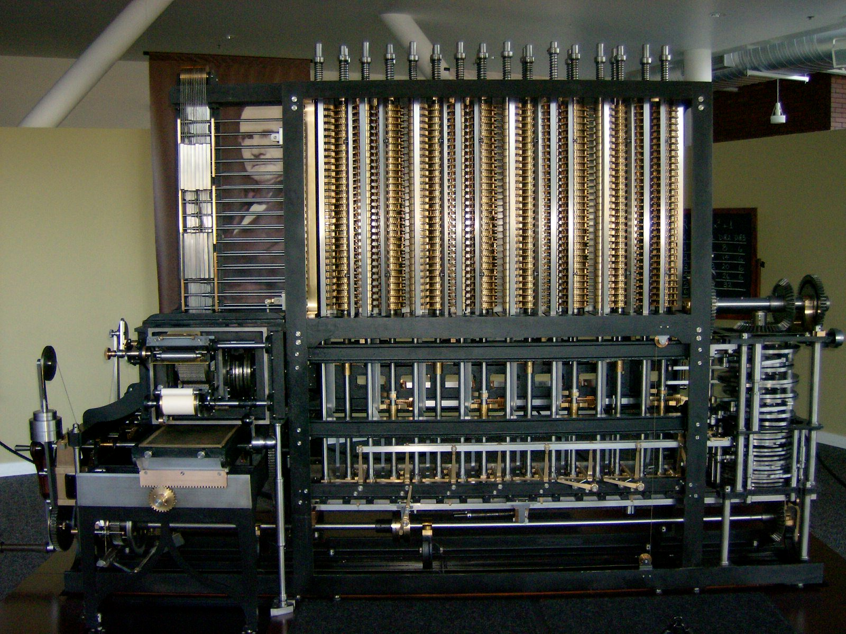
Instruction fetch + decode + ALU
= Babbage’s engine
+ speed
+ reliability
– hand crank
Notes:
A Babbage engine allows the values of the polynomial to be produced without ever having to multiply. A babbage engine only needs to be able to add!
This is why a babbage engine is also called a difference engine
A Babbage Engine (Difference Engine) is an automatic, mechanical calculator designed to tabulate polynomial functions. Both logarithmic and trigonometric functions can be approximated by polynomials, so a difference engine can compute many useful sets of numbers. -- http://en.wikipedia.org/wiki/Difference_engine

Slide 54
Arithmetic Instructions: Shift
00000000000001000100000110000000
op | - | rt | rd | shamt | func
6 bits | 5 bits | 5 bits | 5 bits | 5 bits | 6 bits
R-Type
op | func | mnemonic | description
0x0 | 0x0 | SLL rd, rt, shamt | R[rd] = R[rt] << shamt
0x0 | 0x2 | SRL rd, rt, shamt | R[rd] = R[rt] >>> shamt (zero ext.)
0x0 | 0x3 | SRA rd, rt, shamt | R[rd] = R[rt] >> shamt (sign ext.)
ex: r8 = r4 * 64 # SLL r8, r4, 6
r8 = r4 << 6

Slide 55
Shift
Prog.
Mem
Reg.
File
inst
ALU
r8
r4
+4
5
5
5
sll
shamt = 6
PC
sll
control
shamt
Fetch
Decode
Execute
Memory
WB
skip
ex: r8 = r4 * 64 # SLL r8, r4, 6
r8 = r4 << 6

Slide 56
Arithmetic Instructions: Immediates
00100100101001010000000000000101
op | rs | rd | immediate
6 bits | 5 bits | 5 bits | 16 bits
I-Type
op | mnemonic | description
0x9 | ADDIU rd, rs, imm | R[rd] = R[rs] + imm
0xc | ANDI rd, rs, imm | R[rd] = R[rs] & imm
0xd | ORI rd, rs, imm | R[rd] = R[rs] | imm
op | mnemonic | description
0x9 | ADDIU rd, rs, imm | R[rd] = R[rs] + sign_extend(imm)
0xc | ANDI rd, rs, imm | R[rd] = R[rs] & zero_extend(imm)
0xd | ORI rd, rs, imm | R[rd] = R[rs] | zero_extend(imm)
ex: r5 = r5 + 5 # ADDIU r5, r5, 5
r5 += 5
What if immediate is negative?
ex: r5 += -1
ex: r5 += 65535

Slide 57
Immediates
Prog.
Mem
r5
Reg.
File
inst
ALU
r5
+4
5
5
5
addiu
PC
addiu
control
5
imm
extend
shamt
ex: r5 = r5 + 5 # ADDIU r5, r5, 5
r5 += 5
Fetch
Decode
Execute
Memory
WB
skip

Slide 58
Immediates
Prog.
Mem
r5
Reg.
File
inst
ALU
r5
+4
5
5
5
addiu
PC
addiu
control
5
imm
extend
shamt
ex: r5 = r5 + 5 # ADDIU r5, r5, 5
r5 += 5
Fetch
Decode
Execute
Memory
WB
skip

Slide 59
Arithmetic Instructions: Immediates
00111100000001010000000000000101
op | - | rd | immediate
6 bits | 5 bits | 5 bits | 16 bits
I-Type
op | mnemonic | description
0xF | LUI rd, imm | R[rd] = imm << 16
ex: r5 = 0x50000 # LUI r5, 5
ex: LUI r5, 0xdead
ORI r5, r5 0xbeef
What does r5 = ?
r5 = 0xdeadbeef

Slide 60
Immediates
Prog.
Mem
Reg.
File
inst
ALU
r5
liu
+4
5
5
5
5
PC
liu
control
16
imm
extend
shamt
ex: r5 = 0x50000 # LUI r5, 5
Fetch
Decode
Execute
Memory
WB
skip
Notes:
or, extra input to alu B mux from before/after extend
(or, extra mux after alu)

Slide 61
MIPS Instruction Types
Arithmetic/Logical
  R-type: result and two source registers, shift amount
  I-type: 16-bit immediate with sign/zero extension
Memory Access
  load/store between registers and memory
  word, half-word and byte operations
Control flow
  conditional branches: pc-relative addresses
  jumps: fixed offsets, register absolute
Next
Time

Slide 62
Summary
We have all that it takes to build a processor!
  Arithmetic Logic Unit (ALU)—Lab0 & 1, Lecture 2 & 3
  Register File—Lecture 4 and 5
  Memory—Lecture 5
    SRAM: cache
    DRAM: main memory
A MIPS processor and ISA (instruction set architecture) is an example a Reduced Instruction Set Computers (RISC) where simplicity is key, thus enabling us to build it!!
We know the data path for the MIPS ISA
register and memory instructions

